Slide 1
WorkshopPLUS Power Platform for Administrators
Power Platform Policies
Notes:
Workshop Version: 2.6

Slide 2
Conditions and terms of use
© Microsoft Corporation. All rights reserved.
You may use these training materials solely for your personal internal reference and non-commercial purposes. You may not distribute, transmit, resell or otherwise make these training materials available to any other person or party without express permission from Microsoft Corporation. URL’s or other internet website references in the training materials may change without notice. Unless otherwise noted, any companies, organizations, domain names, e-mail addresses, people, places and events depicted in the training materials are for illustration only and are fictitious. No real association is intended or inferred. THESE TRAINING MATERIALS ARE PROVIDED “AS IS”; MICROSOFT MAKES NO WARRANTIES, EXPRESS OR IMPLIED IN THESE TRAINING MATERIALS

Slide 3

Objectives
After completing this Learning, you will be able to:
 | 1 | Understand…. What Power Platform Data Loss Prevention Policies are Who can Create and managed DLP policies How DLP policies are enforced and visible to users What granular DLP controls are DLP management interfaces
 | 2 | Understand…. What tenant isolation policy is Different configuration scenarios for tenant isolation
 | 3 | Understand…. What Customer lockbox is Workflow of customer lockbox once it is configured
 | 4 | Understand…. What Enterprise policies are
 | 5 | Understand…. What Billing policies are How Billing policies are configured

Slide 4
Understand Data Loss Prevention Policies

Slide 5
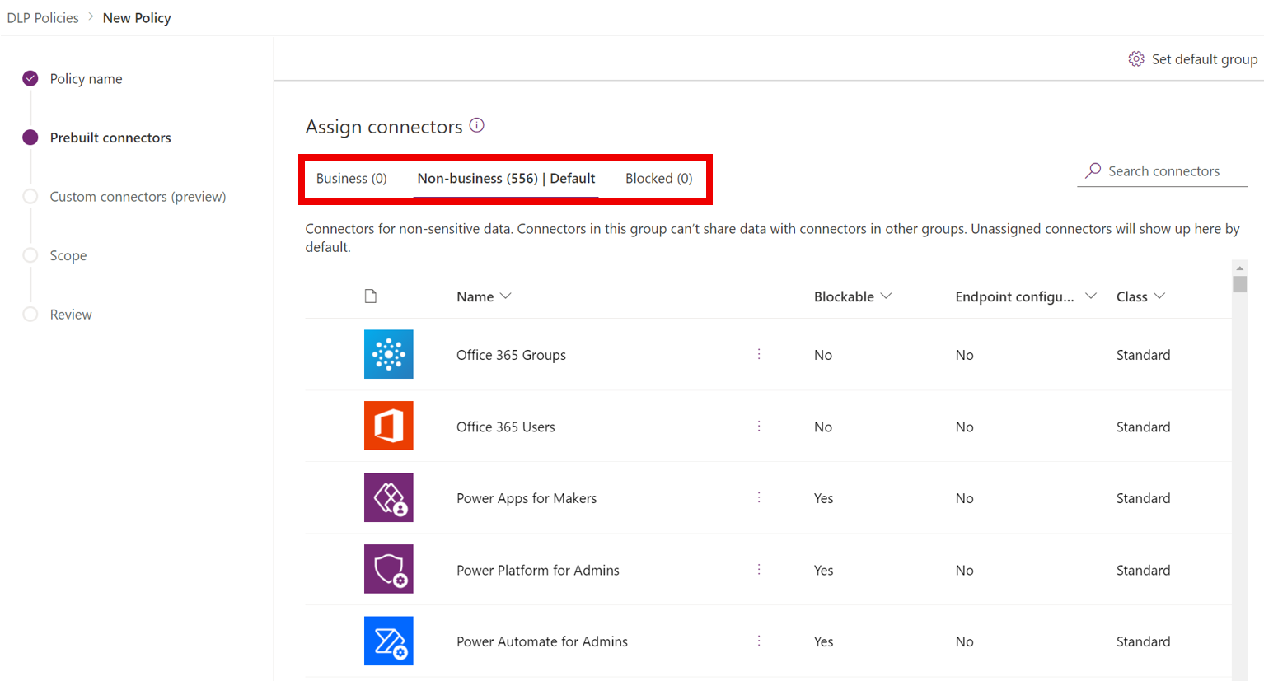
What are Data Loss Prevention (DLP) policies?
Power Platform DLP policies allow you to control data flows across data connectors when used within Power Apps and Power Automate.
Simply put, DLP enables admins to isolate business data from personal use data within Power Platform.
Microsoft Confidential
Notes:
Simply put, DLP enables admins to isolate business data from personal use data within powerplatform.
They can do so by classifying power platform connectors across business and non-business groups using DLP. They can additionally choose to block certain connectors from use within power platform.
As you see on the user interface here the DLP policy allows admins to segregate connectors across three different buckets – Business, Non-business and blocked

Slide 6
Connector Classification
Connectors can be classified across the following groups using DLP policies:
Business
A given Power App or Power Automate resource can use one or more connectors from Business group
If a Power App or Power Automate resource uses a Business connector, it cannot use any Non-business connector
Non-business
A given Power App or Power Automate resource can use one or more connectors from Non-business group
If a Power App or Power Automate resource uses a Non-business connector, it cannot use any Business connector
Blocked
Any Power App or Power Automate resource cannot use any connector from a Blocked group
All Microsoft owned premium connectors and third-party connectors (standard and premium) can be blocked
All Microsoft owned standard connectors and Microsoft Dataverse cannot be blocked
Microsoft Confidential
Notes:
So just to recap – power platform DLP supports three types of connector classification. Business and non-business groupings govern which connectors can be used together vs. not. Allowing you to segregate business sensitivie data from non-business data. Blocked on the other hand blocks the connector from use altogether. Power platform allows blocking of all Microsoft owned Premium connectors as well as all third party stanrrd and premium connectors. However Microsoft owned standard connectors such a O365 and native Power platform connectors as well as Dataverse are not blockable and can only be classified as business/non-business.
Do please note that the DLP connector classification is not set in stone at the time of creating the policy. Admins can change the classification of connectors at a future time by editing the DLP policy based on thier evolving business needs.

Slide 7
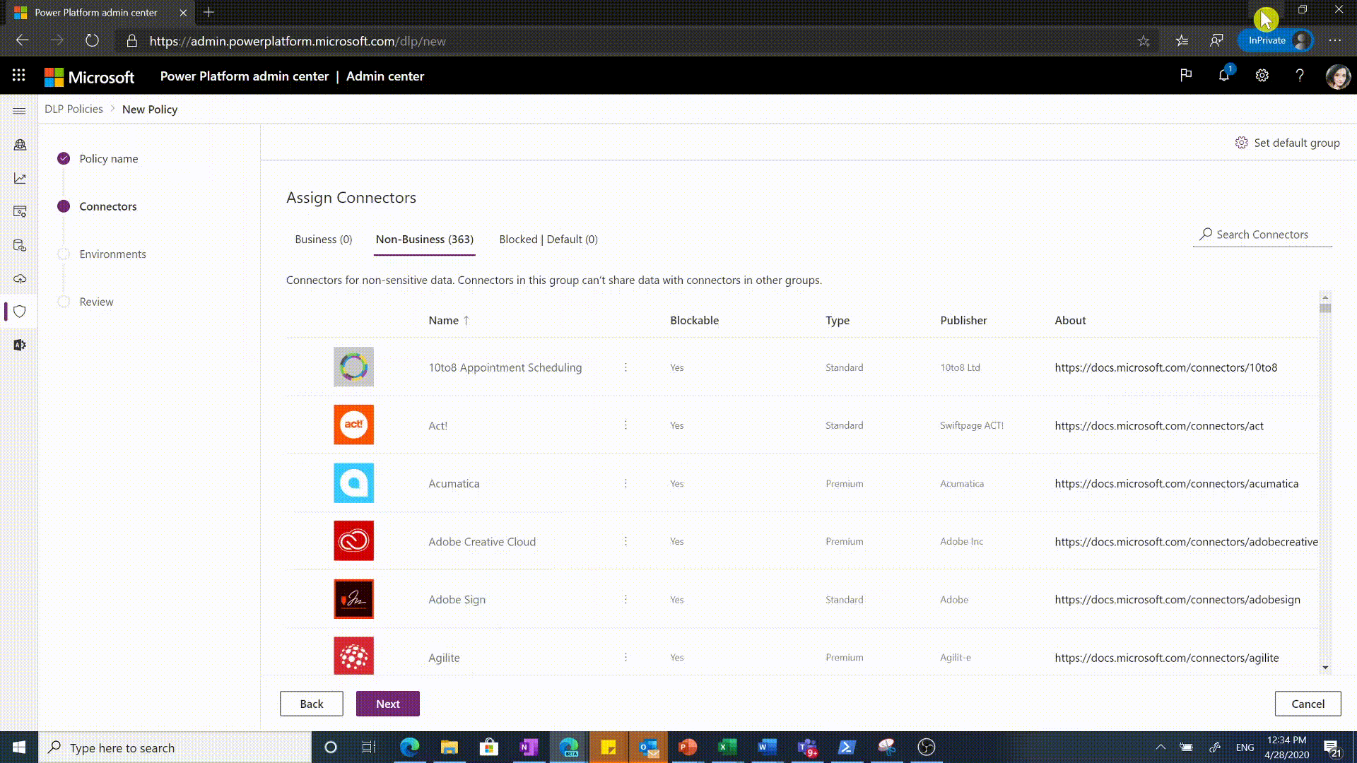
Default Connector Group
The following grouping logic is applied to new connectors added to Power Platform:
Power Platform connector ecosystem keeps evolving and new connectors are added.
If new connectors are added after DLP policy creation, admins have not had a chance to explicitly categorize them
These new connectors are automatically added to Default connector group identified for them
Admins can set the Default connector group for new connectors in a DLP policy to – Business or Non-business or Blocked
Admins can review these new connectors retrospectively and classify them explicitly as appropriate
There are templates in Power Automate for administrators to get alerts when new connectors are added - Monitor new connectors - Microsoft Power Platform - Power Platform | Microsoft Learn
Microsoft Confidential
Notes:
Before we move on from connectors to other DLP concepts, a quick note on what happens to the new connectors that get added to connector ecosystem *after* you have finished creating the DLP policy. As you can see here, there is a default categorization setting for new connectors that you can assign to your DLP policy. All three categories – Business, Non-Business and Blocked are available for you to choose from. Non-business is the default set up for new connectors if you don’t edit this setting.
For example, say Power Platform introduces a new connector for Zendesk. Some organizations may use it for business scenarios, and some may not. If the default grouping for new connectors in your DLP policy is set as blocked, when Zendesk gets introduced, it will be mapped as a blocked connector. As admins note the new connector being available, they can then review its details when they get time and move Zendesk to the appropriate business or non-business group by editing their DLP policy.
A small caveat - if you select ‘Blocked’ as the default categorization for new connectors is that if any Microsoft owned standard connectors are added which are exempt from blocking by definition, these will get mapped into non-business instead of blocked category. All other connectors would still map to blocked as expected.

Slide 8
Tenant and Environment Policies
Power Platform DLP allows admins to create two types of policies
Tenant level DLP policies
Supported only for Power Platform, D365 and Global Administrator roles
Can be applied to one, more than one or all environments at a time
Can be created without associating any environment
Can be edited and viewed by any tenant admin
Connector settings are visible to all relevant environment admins but are not editable by them
Cannot be used to manage custom connector policies since they are scoped to a specific environment
Environment level DLP policies
Supported for Environment Admin role associated with the environment
Can be applied to only one environment at a time
Specifying the environment is mandatory to create the policy
Can be edited and viewed by any environment admin (of the environment) and tenant admins
Can be used to manage custom connectors for their environment
Microsoft Confidential
Notes:
Let us now look at the types of DLP policies. Power Platform supports– tenant level and environment level policies. The key difference between these two is that tenant level policies can be associated with more than one environment in the tenant, while the environment level policies only apply to a single environment at a time. Tenant level policies can only be created by tenant admin roles such as Power Platform administrator,. As mentioned earlier, tenant level policies are multi-environment and can be applied to one, more than one or all environments. These policies can be viewed and updated by any tenant admin even if they were not the original creator of the policy. Environment admins can also view tenant level policy settings since these do impact data flow for their environments. They are however not allowed to edit these policies. A key limitation for tenant level policies is – that they do not support custom connectors’ set up. This is because custom connectors are tied to a particular environment and are not available for multiple environments at a time.
Let us now look at environment level policies. These can be created by designated environment admins and have a 1:1 mapping to a single environment. All environment admins for the applicable environment as well as tenant admins can view and update environment level policies. Environment level policies do support custom connectors’ classification, through DLP powershell cmdlets. DLP UI support for custom connector classification is currently not available.

Slide 9
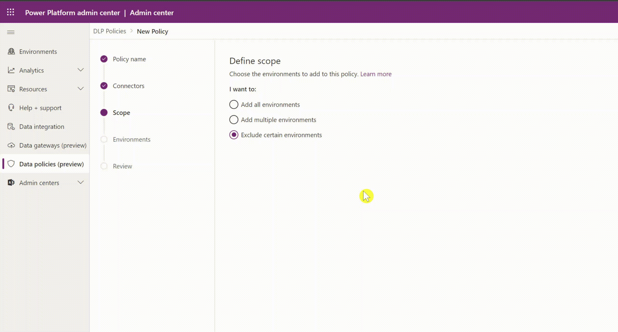
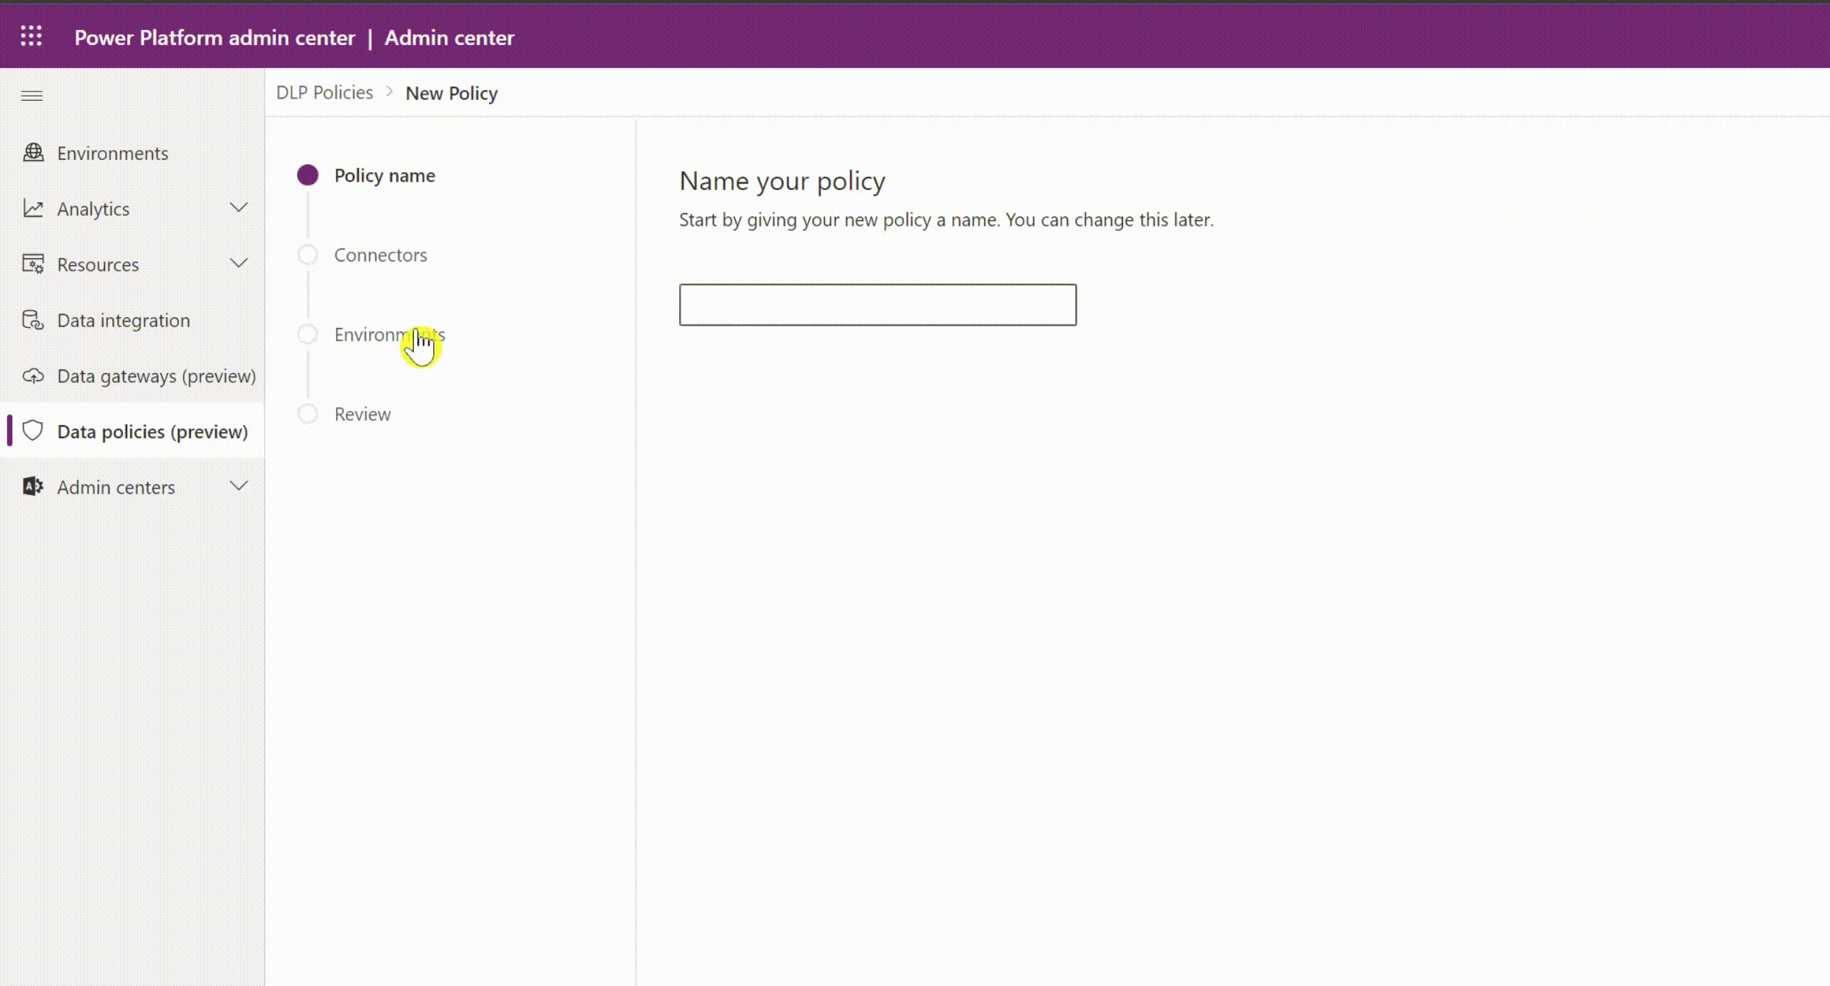
DLP Policy Scopes
Tenant policies have three scope settings
All environments
By default, tenant level policies will be applied to all environments created in the tenant.
All except selected environments
Tenant admins can choose to exclude specific environments to apply the policy.
Only selected environments
Tenant admins can choose to include only specific environments to apply the policy.
Environment policies have one scope setting
One environment only
Environment admins can choose to apply the policy on one environment at a time.
Microsoft Confidential
Notes:
Let us dive deeper into DLP policy’s environment scope setting across the two policy types. As mentioned, tenant level policies are multi-environment. They support three different scope settings for admins to choose from. By default tenant policies apply to ‘all environments’. Admins can however choose to exclude certain environments’ from DLP policy and apply it to the remaining environments. This will bring up the environment selection step to allow admins to exclude relevant environments. Alternately, admins can apply the policy only to select set of environments by choosing ‘add multiple environments’ option. This will also bring up the Environment selection step in the DLP policy wizard to choose the relevant environments to include. It is typical of tenant admins to use a complimentary combination of exclude environments and include environments policies to manage the unique connector settings for different stakeholders across their org. We will see one such example on the next slide.
On the other hand, environment policies can only be applied to one environment at a time and environment selection is mandatory at the time of creating the policy. Multi-environment selection is not available for environment policies even if a particular environment admin may be managing more than one environment. They will need to create individual DLP policies for each environment they manage or coordinate with tenant admins to set up multi-environment tenant level policies. Do note that the DLP policy scope can be updated after the policy creation. Tenant admins can change the scope selection between the three available options as well as add or delete specific environments to the list. Similarly, environment admins can also change the environment to which the policy is applied.

Slide 10
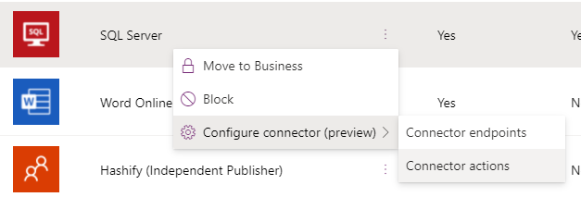
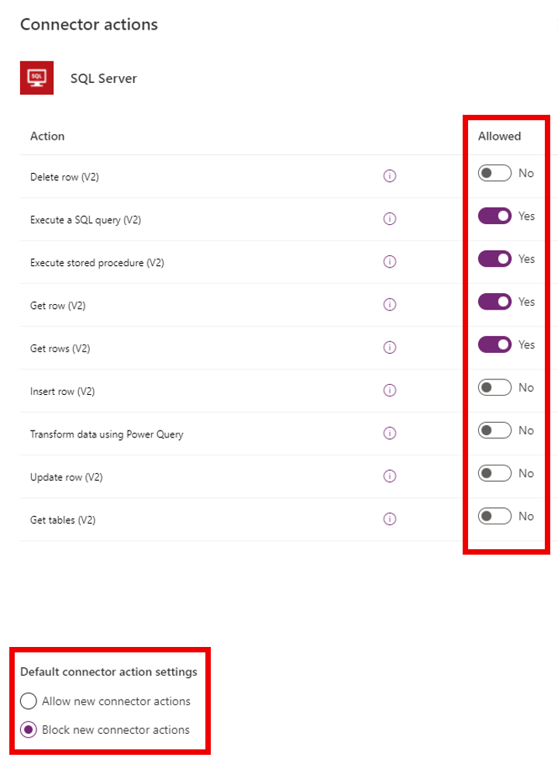
Connector Action Control
Granular DLP Controls
You can use connector action control to allow or block individual actions within a given connector.
On the Connectors page, right-click the connector, and then select Configure connector > Connector actions.
You can also set the default value (Allow or Deny) for any new connector actions that will be added to the connector in the future.
Possible to use PowerShell as well to configure Connector Actions for DLP policies. See more here
Microsoft Confidential

Slide 11
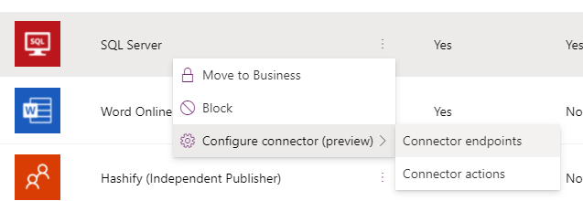
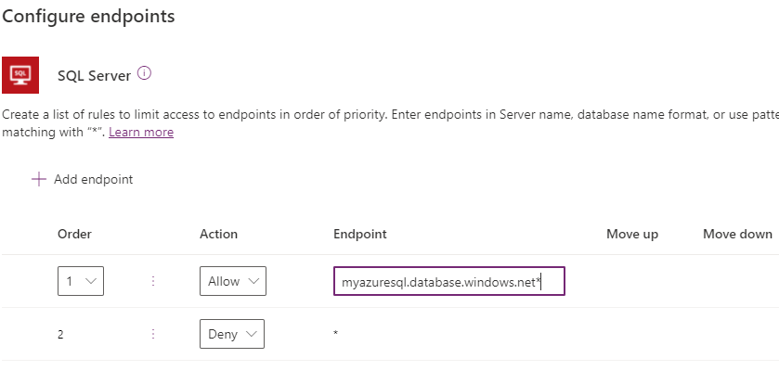
Endpoint Filtering (Preview)
Granular DLP Controls
Endpoint filtering allows admins to govern at a fine grain which specific endpoints will be allowed versus blocked at a tenant or environment level.
This feature is available for HTTP, HTTP with Azure AD, HTTP Webhook, SQL Server, Azure Blob Storage, and SMTP connection endpoints (soon also for Dataverse (legacy)).
Possible to use PowerShell as well to configure Endpoint Filtering for DLP policies. See more info here
Microsoft Confidential

Slide 12
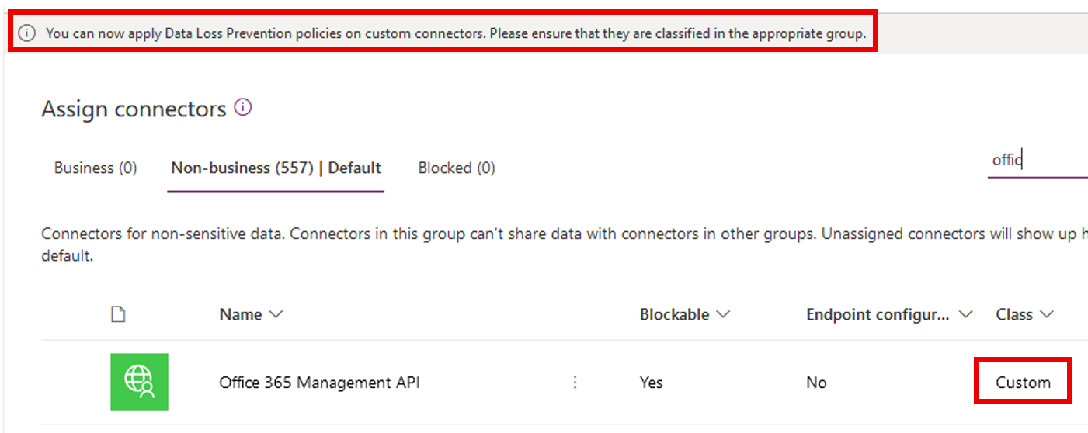
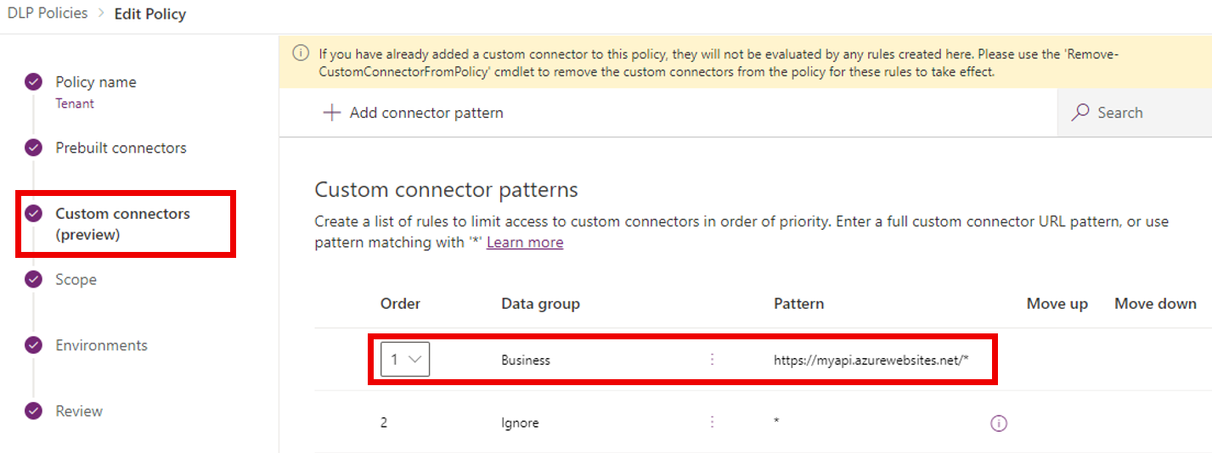
Custom Connector Parity
Power Platform allows you to create and share custom connectors which can be included in tenant and environment level Data Loss Prevention (DLP) policies.
Environment admins can now see all custom connectors in their environments in DLP wizard in PPAC and classify individual custom connectors by name for environment-level DLP policies.
Tenant admins see a new tab called Custom connectors in DLP wizard in PPAC which allows them to specify an ordered list of Allow and Deny URL patterns for custom connectors.
The rule for * will always be the last entry in the list which applies to all custom connectors not matched by any previous rule.
Admins can tag the * pattern to Blocked/Business/Non-business/Ignore. By default, the pattern is set up as Ignore for new DLP policies.
DLP for custom connectors
Microsoft Confidential
Notes:
Tenant admins will see a new tab in the Data Policies wizard called Custom connectors, which will allow them to specify an ordered list of Allow and Deny URL patterns for custom connectors.
The rule for * will always be the last entry in the list which applies to all custom connectors not matched by any previous rule.
Admins can tag the * pattern to Blocked/Business/Non-business/Ignore. By default, the pattern is set up as Ignore for new DLP policies.
Ignore essentially means ignore DLP classification for all connectors in this tenant level policy and defer evaluation of a pattern to other environment or tenant-level policies to attribute them into business/non-business/blocked grouping as appropriate. If no specific rule exists for the custom connectors, then an “Ignore *” rule will allow custom connectors to be used with both business and non-business connector groupings. Ignore as an action is not supported for any other URL pattern added to the custom connector pattern rules except the last entry in the list.

Slide 13
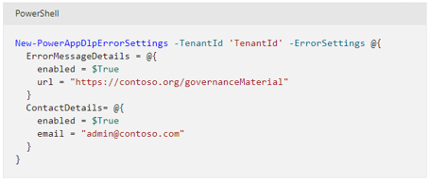
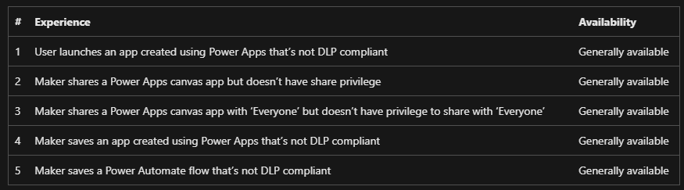
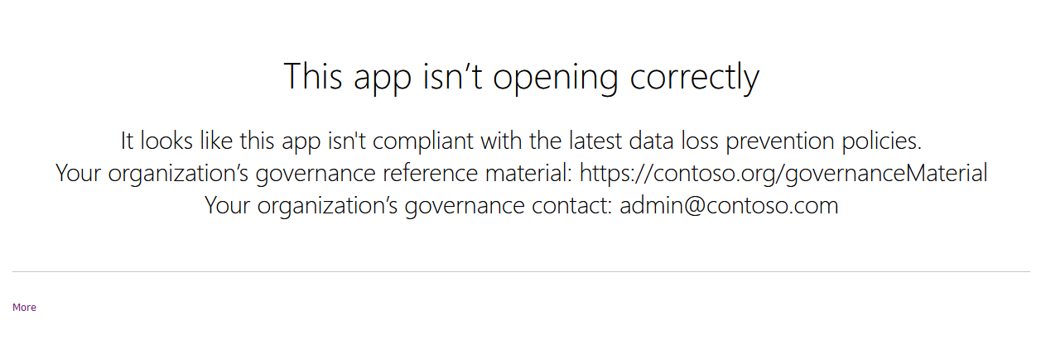
Custom DLP Governance Error Message
You can use Power Platform DLP PowerShell commands to set a custom link to lead end users to your organization’s governance documentation and include a governance contact, when they are prompted by governance controls.
For instance, when the governance error message content is set, it will appear in Power Apps Data Loss Prevention policy runtime enforcement messages.
Governance error message content commands
Microsoft Confidential

Slide 14
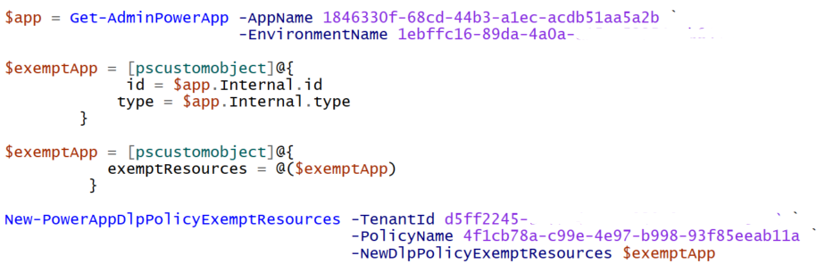
DLP Resource Exemption
You can use Power Platform DLP PowerShell commands to exempt or unexempt Apps and Flows from DLP policies.
For example, by using following commands you can exempt App from specified DLP policy.
NOTE: Currently, there is no UI to be able to see all Apps and Flows excluded from the policies, so admins would need to track and monitor excluded resources – you can retrieve list of exempt resources via PowerShell.
DLP resource exemption cmdlets
Microsoft Confidential

Slide 15

Demonstration
Create tenant level Data Loss Prevention policy
Consider demoing the following:
Open PPAC
Click Data Policies from the left menu
Click New Policy
Set policy name as “Tenant Policy”
In the connectors list (Non-Business) filter all non-blockable connectors by settings filter for Blockable column with value No
Select all connectector (about 24) and move them to Business group and click Next
Do not change anything in Custom Connectors page just click Next
On the Scope page select “Add all environments” and click Next
In the last page click “Create policy”
Notes:
Consider demoing the following:
Open PPAC
Click Data Policies from the left menu
Click New Policy
Set policy name as “Tenant Policy”
In the connectors list (Non-Business) filter all non-blockable connectors by settings filter for Blockable column with value No
Select all connectector (about 24) and move them to Business group and click Next
Do not change anything in Custom Connectors page just click Next
On the Scope page select “Add all environments” and click Next
In the last page click “Create policy”
##########

Slide 16




Example - Contoso Corp DLP policies
1. MOST RESTRICTIVE DLP
(Tenant policy, All envs except)
3. CONTOSO TAX DLP
(Tenant policy, Include envs)
5. CENTRAL IT DLP
(Tenant policy, Include envs)
Any New Environments
Dev
Dev
Dev
Test
Test
Test
Contoso Default Environment
Contoso USA Tax Environments
Prod
Contoso UK Tax Environments
Prod
Central IT Environment
Prod
PowerApps
Flows
Dataverse
PowerApps
Flows
Dataverse
PowerApps
Flows
Dataverse
PowerApps
Flows
Dataverse
2. LESS RESTRICTIVE DLP
(Tenant policy, Include envs)
4. CONTOSO AUDIT DLP
(Tenant policy, Include envs)
6. SPECIAL PURPOSE DLP
(Environment policy)
Dev
Dev
Contoso Shared Environment
Test
Test
Special Purpose Environment
Contoso USA Audit Environments
Prod
Contoso UK Audit Environments
Prod
PowerApps
Flows
Dataverse
PowerApps
Flows
Dataverse
PowerApps
Flows
Dataverse
PowerApps
Flows
Dataverse
Centralize DLP Policy management using tenant level policies. Use restrictive policies on shared environments like default environment. Create minimal number of policies per environment. There is no strict hierarchy between tenant and environment policies.

Slide 17
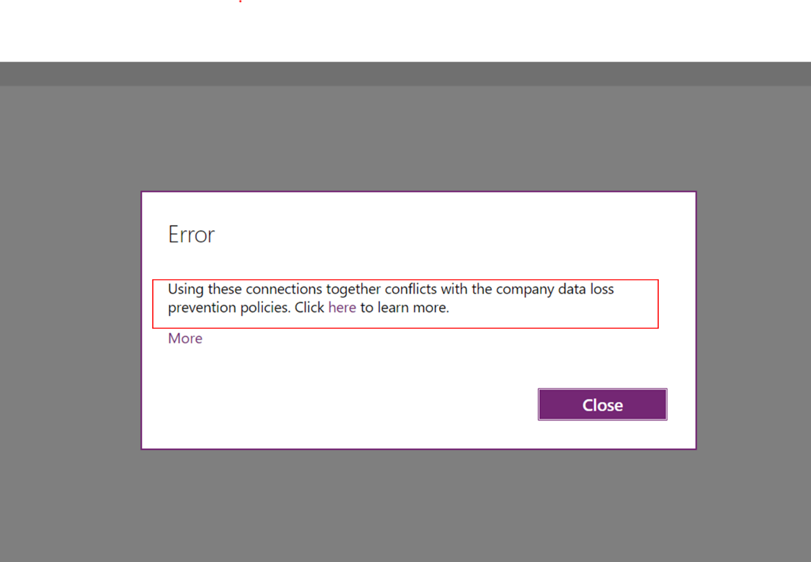
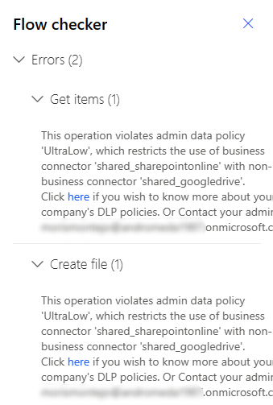
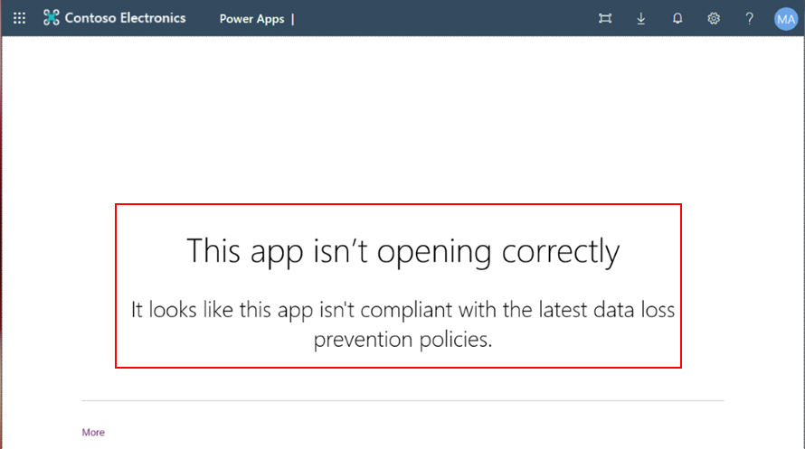
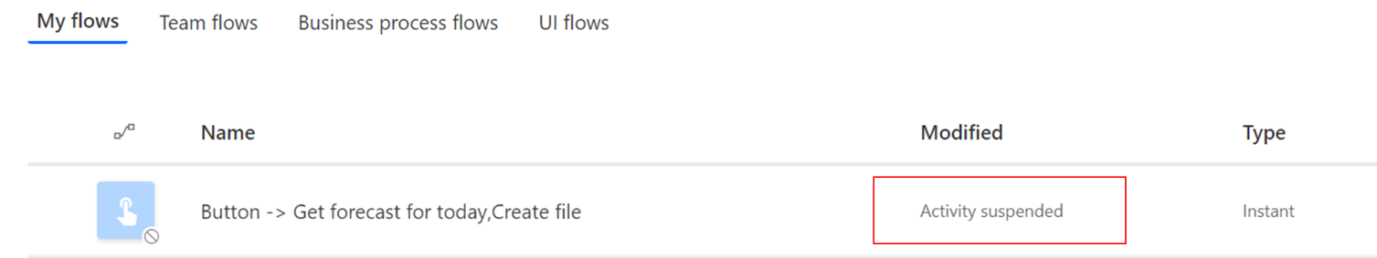
DLP Policy Enforcement
Design-time
Power Apps makers see an error upon using connectors that don’t belong together or are blocked using DLP policies. Apps violating DLP policies cannot be saved at design time unless DLP violation is resolved.
Power Automate makers see a warning while saving a flow using connectors that don’t belong together or are blocked using DLP policies. You can save the flow but not able to run
Run-time
If DLP policy changes impact an existing Power App negatively and it becomes non-compliant, then users are no longer able to launch it and get an error.
If DLP policy changes impact an existing Power Automate negatively and it becomes non-compliant, then it is automatically marked as suspended users are no longer able to execute it. Power Automate suspension may take ~5 mins to come into effect after policy changes.
Microsoft Confidential
Notes:
Lets’ look at an example tenant set up of a financial services org say Contoso corporation. Contoso admins wants to support personal productivity scenarios, business applications as well as center of excellence activity management through power platform apps and flows
The environment strategy Contoso admins have applied here includes the default environment which is auto-created and available for the entire organization with maker privileges, as the shared personal productivity environment. As you are aware there are in-built experiences and customizations across office products like SharePoint which use the default environment in order to integrate with power platform apps and flows. Contoso admins have set up a tenant wide restrictive DLP policy that applies to all environments in the tenant except some specific envs that they have excluded from the policy’s scope. Admins intend to keep the available connectors in this policy limited to O365 and other standard Microsoft services while blocking access to everything else.
Contoso admins have created another shared environment for employees to write apps for personal productivity use cases. This environment has an associated tenant level DLP policy which is not as risk averse as the default policy and allows makers to use connectors like Azure services in addition to the O365 services. Since this is a non-default environments, admins actively control the environment maker list for it. This is a tiered approach to shared personal productivity environments and associated DLP policies.
In addition, for their business units to create line of business applications they have created dev-test-prod environments for their tax and audit subsidiaries across various countries. The environment maker access to these environments is carefully managed and appropriate first- and third-party connectors are made available using tenant level DLP policies, in consultation with the business unit stakeholders.
Similarly, dev-test-prod environments are created for central IT’s use to develop and roll out relevant org wide applications. These business application scenarios typically have a well identified set of connectors that need to be made available for makers, testers and users in these environments. Access to these connectors is managed using a dedicated tenant level policy.
Contoso has a special purpose environment dedicated to their center of excellence activities. In Contoso the DLP policy for special purpose environment will remain super high touch given the experimental nature of the COE team’s work. In this case tenant admins have delegated DLP management for this environment directly to a trusted environment admin of COE team and excluded it from scope of all tenant level policies. This environment is managed only by the environment level DLP policy which is an exception rather than the rule at Contoso.
As expected, any new environment that are created in Contoso will map to the original all environments policy unless tenant admins explicitly exclude them from the policy scope. Do note that this setup of tenant centric DLP policies does not prevent environment admins to come up with their own environment level DLP policies in order to introduce additional restrictions or to classify custom connectors.
A frequent question we get asked is, if tenant policies are the higher order bit and preempt environment policies . Fact is that all applicable policies are evaluated together to enforce the most restrictive data flow rules in the associated environments. There is no strict hierarchy between policies. Tenant level policies cannot be used to remove restrictions imposed by environment level policies and vice versa.

Slide 18
Multiple Policy Impact on Environments
If multiple tenant or environment level policies are applied simultaneously on an environment, then the most restrictive rules accrue.
Blocked connectors
If a connector is marked as ‘blocked’ in any one DLP policy applied to the environment, then the net outcome is that this connector is blocked from usage within the environment.
It doesn’t matter if other DLP policies applied to the environment mark it as business or non-business.
Business/Non-Business connectors
If all DLP policies applied to the environment mark a certain set of connectors as business or non-business, then the most restrictive groupings define what connectors can be used together vs. Not.
For example
Policy X = B {1,2,3} NB {4,5} ; Policy Y = B {3,4,5} NB {1,2}
Then – Net outcome : {1,2} {3} {4,5}
Microsoft Confidential
Notes:
Let’s dive into a complex topic now. The net outcome of multiple tenant and environment level policies is a regular source of questions and confusion that we hear related to power platform DLP. Essentially what happens in multi-policy scenario is that all relevant policies appliable on an environment are evaluated one by one on apps and flows. For an app or flow to successfully execute in that environment, it must comply to *all* DLP policies.
This concept is fairly easy to compute for blocked connectors. If a connector is marked as blocked in any one DLP policy associated with the environment, then that connector cannot be used in any app or flow in that environment, even if other policies consider it as business or non-business. ‘Blocked’ is the most restrictive grouping for a connector and it gets precedence over business or non-business classification.
It does get quite tricky to compute outcome of connector mapping across multiple policies for business/non-business classification. As we have discussed earlier, business/non-business tag itself has no particular significance. The important thing that DLP policies define is rules around which connectors can be used together vs. not. As an example, lets consider the scenario, where policy X and Y were both applied on the same environment. Here policy X identified connectors 1,2,3 to be usable together marking them as business and connectors 4, 5 are usable together marking them as non-business. On the other hand, Policy Y considers connectors 3,4,5 to be usable together marking them as Business, while connectors 1 and 2 are placed together in the non-business group. Net outcome of these grouping restrictions when applied together ensure that connectors 1 and 2 can be used together, and 4 and 5 can be used together. However, connector 3 cannot be used with any of the other 4 connectors. This is net outcome of policy X restricting its usage with 4 and 5, and policy Y restricting its usage with 1 and 2. Altogether the most restrictive settings ensure that connector 3 cannot be used with 1 and 2 as well as 4 and 5.

Slide 19



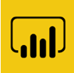






Multiple DLP Policies – Example Scenario
Business Group
POLICY X
Non-Business Group
Blocked Group
Target Environment
Business Group
POLICY Y
Non-Business Group
Blocked Group
PowerApps
Flows
Dataverse
Business Group
POLICY Z
Non-Business Group
Blocked Group
Multiple DLP policies applied to the same environment grouping connectors across Business/Non-business/Blocked. This set up makes the outcome of what connectors can be used together – Fragmented and hard to predict
Notes:
Let’s use a more complex example to illustrate that multiple-policies applied on the same environment can fragment your connector space into unpredictable groupings.
Here we have three policies X, Y and Z subdividing the same 10 connectors across Business, Non-Business and Blocked groups. All three policies are applied to the same target environment.
Here computing outcome for Twitter and HTTP connectors will be simple since they are marked as block in at least one DLP policy. Remaining 8 connectors are going to be hard to predict given the difference in their settings across the 3 policies.

Slide 20

Multiple DLP Policies – Net Outcome
(PX.B, PY.B, PZ.B) Group 1
(PX.B, PY.B, PZ.NB) Group 2
(PX.B, PY.NB, PZ.B) Group 3
POLICY X
POLICY Y
POLICY Z
Target Environment
(PX.B, PY.NB, PZ.NB) Group 4
(PX.NB, PY.B, PZ.B) Group 5
(PX.NB, PY.B, PZ.NB) Group 6
PowerApps
Flows
Dataverse
(PX.NB, PY.NB, PZ.B) Group 7
(PX.NB, PY.NB, PZ.NB) Group 8
Blocked Group 9
All blocked connectors map to blocked. For business/non-business - 3 policies will fragment connector grouping outcome into as many as 3^2 = 8 different sets For predictable outcomes use minimal number of DLP policies per environment
Notes:
Let's represent the outcome of applying polices X, Y and Z on the same environment using the permutation of Business and non-business grouping across the 3 policies. This will give us 2 ^3 or 8 different possible permutations of connector groupings. Let's add a 9th group = that of blocked connectors.
We will place twitter and http in group 9 in keeping with the simple attribution of block connector being most restrictive DLP behavior.
Starting now with the first group we will identify the connectors that are place in the business group across all three policies. This only bubbles up O365 video and O365 Users connectors which we will place in this group. Similarly, we can plumb other 7 permutations.
Net outcome being – o365 video and users are the only connectors can be used together. Simiarly Azure IoT central and PowerBI are the only connectors that can be used together. SQL can only be used standalone, similarly for bing search. And lastly Microsoft translator and gmail can only be used with each other. Twitter and HTTP connectors cannot be used at all.
This combined outcome of 3 policies is hard to predict based on the individual policies’ set up. For predictable outcome of DLP settings we recommend to keep the number of simultaneous DLP policies active on any environment to a bare minimal. Regularly triage conflicting or overlapping policies and converge them into smaller number of policies.
This concludes our discussion on DLP concepts.

Slide 21
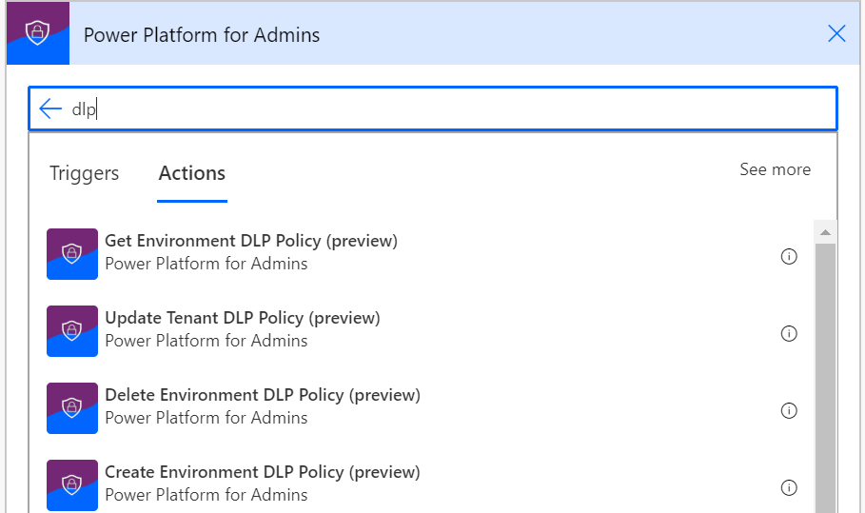
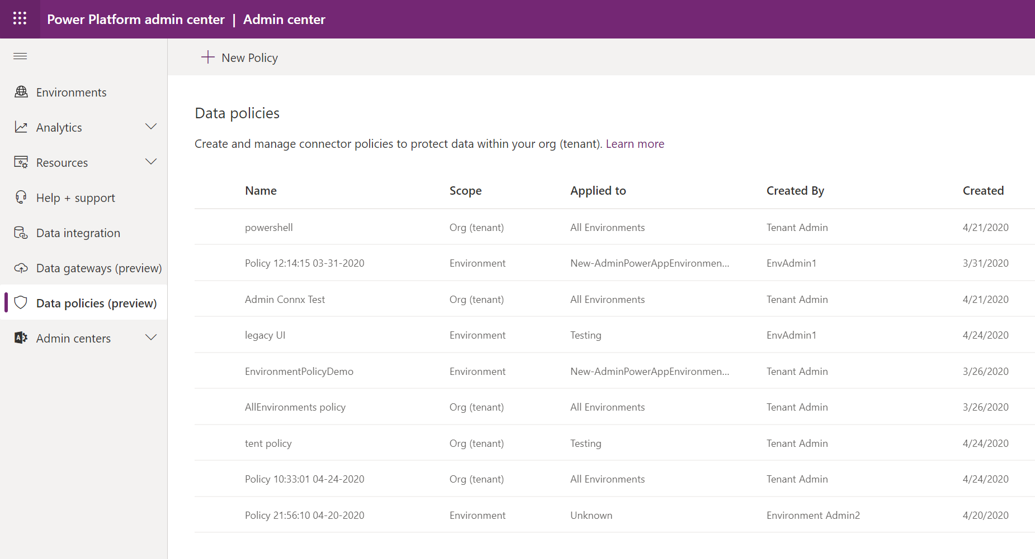
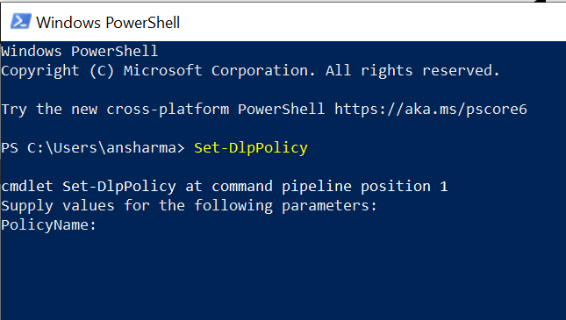
DLP Management Interfaces
Power Platform for Admins Connector
Power Platform Admin Center
Power Apps PowerShell
Microsoft Confidential

Slide 22
Tenant Isolation

Slide 23
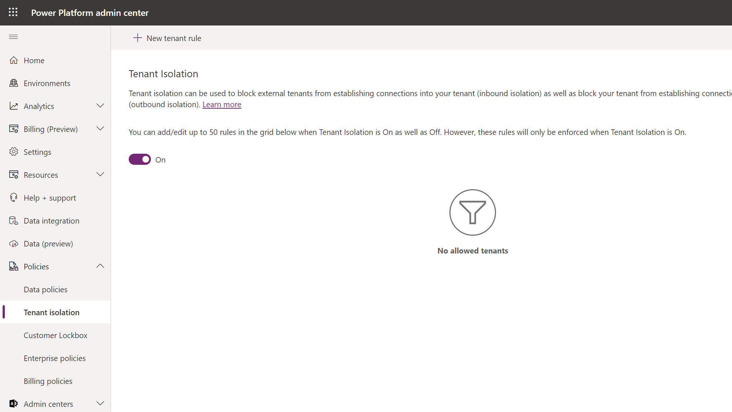
Tenant Isolation
This restriction only applies to PowerApps and Power Automate
Tenant isolation allows admins to effectively govern the movement of tenant data from Azure AD authorized data sources to and from their tenant.
Currently in preview and available in Power PPAC > Policies > Tenant isolation. (Default setting is off).
New Tenant Rule can be created for Inbound and/or Outbound Restriction once Tenant Isolation is turned on.
Tenant domain or ID to be added to the Allowed list, you can use * for all tenants.
Users who create or edit a resource affected by the tenant isolation policy will see a related error message.
Existing Apps or flows that are in violation of the tenant isolation policy won't run successfully.
Additional information.
Microsoft Confidential
Notes:
https://docs.microsoft.com/en-us/power-platform/admin/cross-tenant-restrictions

Slide 24
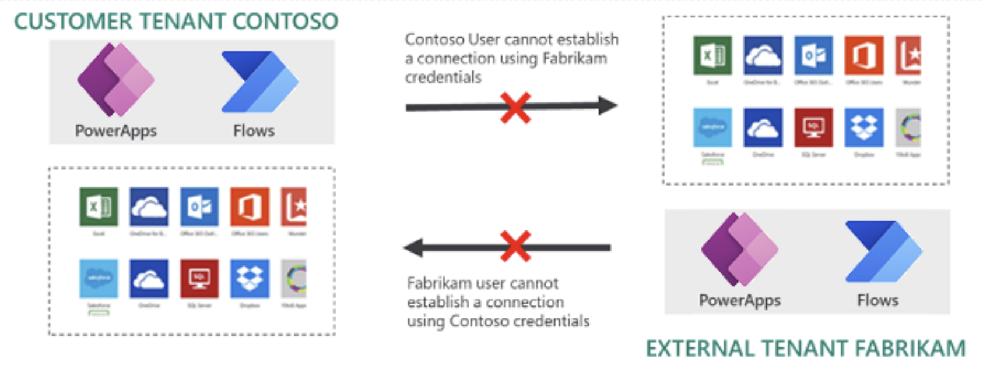
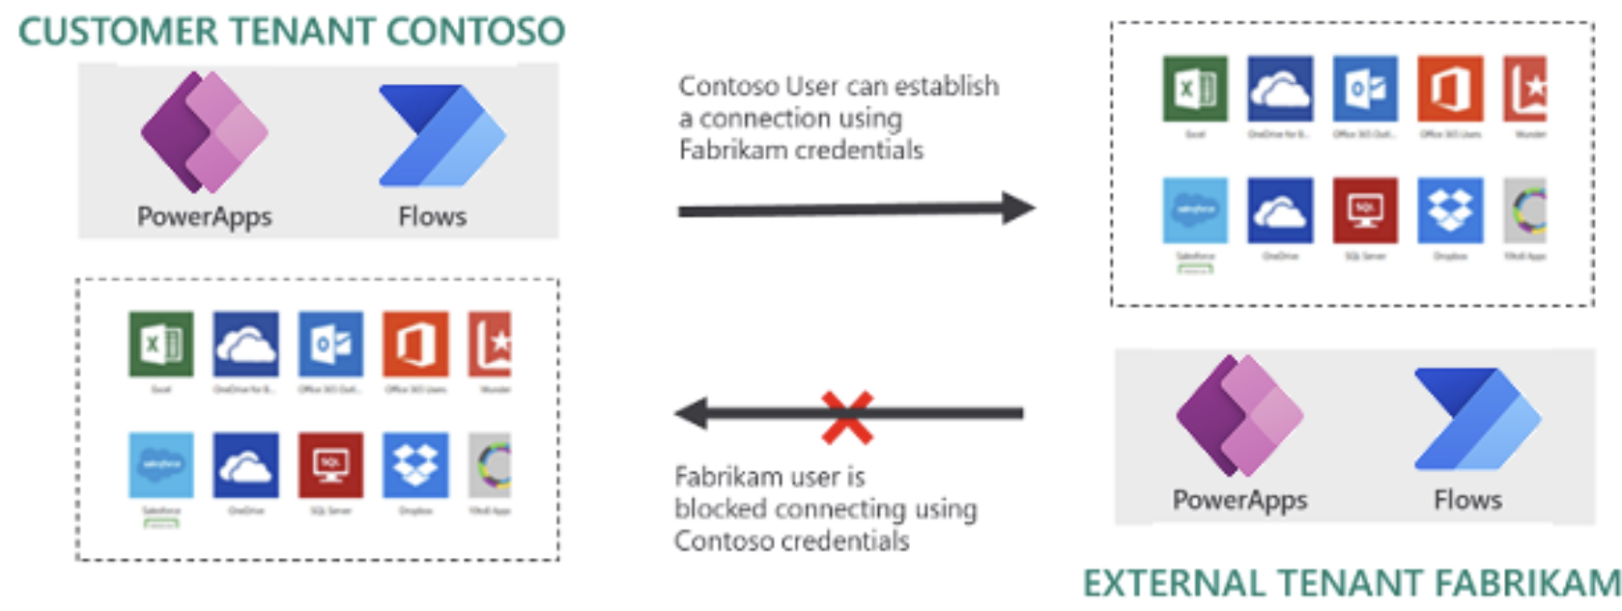
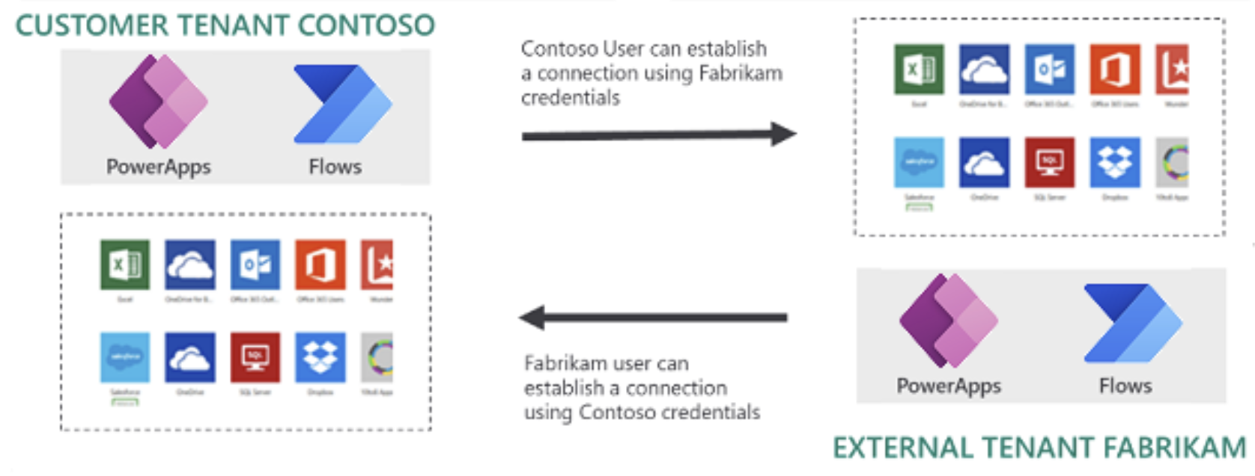
Configuration scenarios
Two-way tenant isolation (inbound and outbound connection restriction).
This restriction only applies to PowerApps and Power Automate
Two-way tenant isolation (inbound and outbound connection restriction).
Two-way tenant isolation will block connection establishment attempts to your tenant from other tenants. Additionally, two-way tenant isolation will also block connection establishment attempts from your tenant to other tenants.
Tenant isolation with allowlists
One-Way tenant isolation or inbound isolation will block connection establishments attempts to your tenant from other tenants.
Scenario: Outbound allowlist – Fabrikam is added to outbound allowlist of the Contoso tenant.
Scenario: Bidirectional allowlist – Fabrikam is added to the inbound and outbound allowlists of the Contoso tenant
Note: a connection attempt initiated by a guest user from their host tenant targeting data sources withing the same host tenant is not evaluated by the tenant isolation rules.
Scenario: Outbound allowlist
Scenario: Bidirectional allowlist
Microsoft Confidential
Notes:
https://docs.microsoft.com/en-us/power-platform/admin/cross-tenant-restrictions

Slide 25
Customer Lockbox

Slide 26
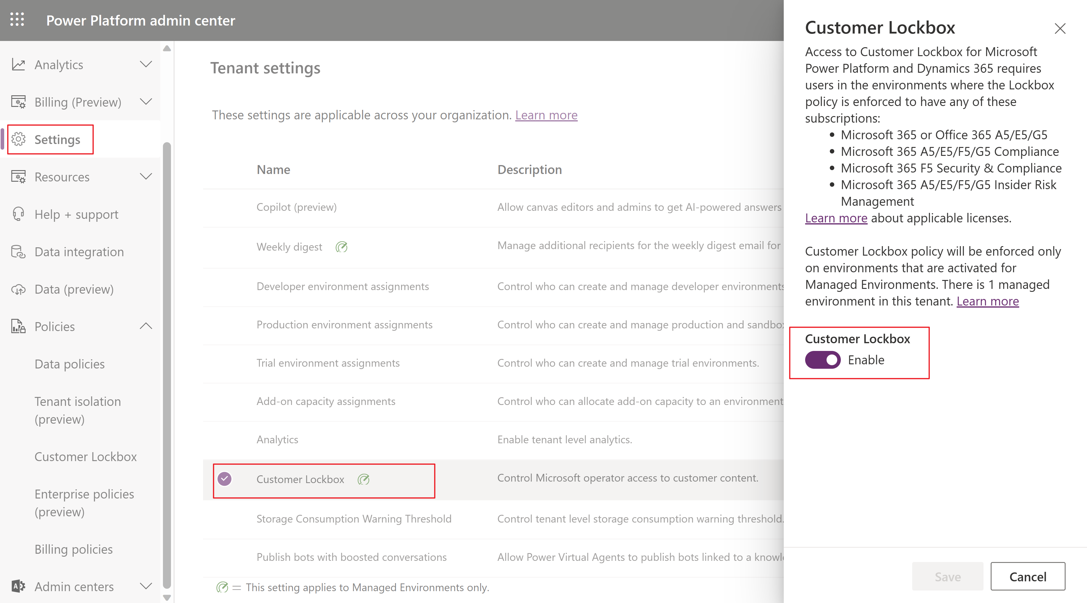
Customer Lockbox
Most operations, support, and troubleshooting performed by Microsoft personnel (including sub-processors) don't require access to customer data. With Power Platform Customer Lockbox, we provide an interface for the customers to review and approve (or reject) data access requests in the rare occasion when data access to customer data is needed. It's used in cases where a Microsoft engineer needs to access customer data, whether in response to a customer-initiated support ticket or a problem identified by Microsoft.
Power Platform applications and services store customer data in several Azure storage technologies. When Customer Lockbox is enabled for an environment, customer data associated with the respective environment is protected by the lockbox policy, irrespective of the storage type.
To enable, go to PPAC > Settings > Customer Lockbox
Enabling Customer Lockbox will enforce the policy only for Managed Environments.
All updates to a lockbox request are recorded and made available via audit logs - Audit lockbox requests.
Microsoft Confidential
Notes:
Securely access customer data using Customer Lockbox in Power Platform and Dynamics 365 - Power Platform | Microsoft Learn

Slide 27
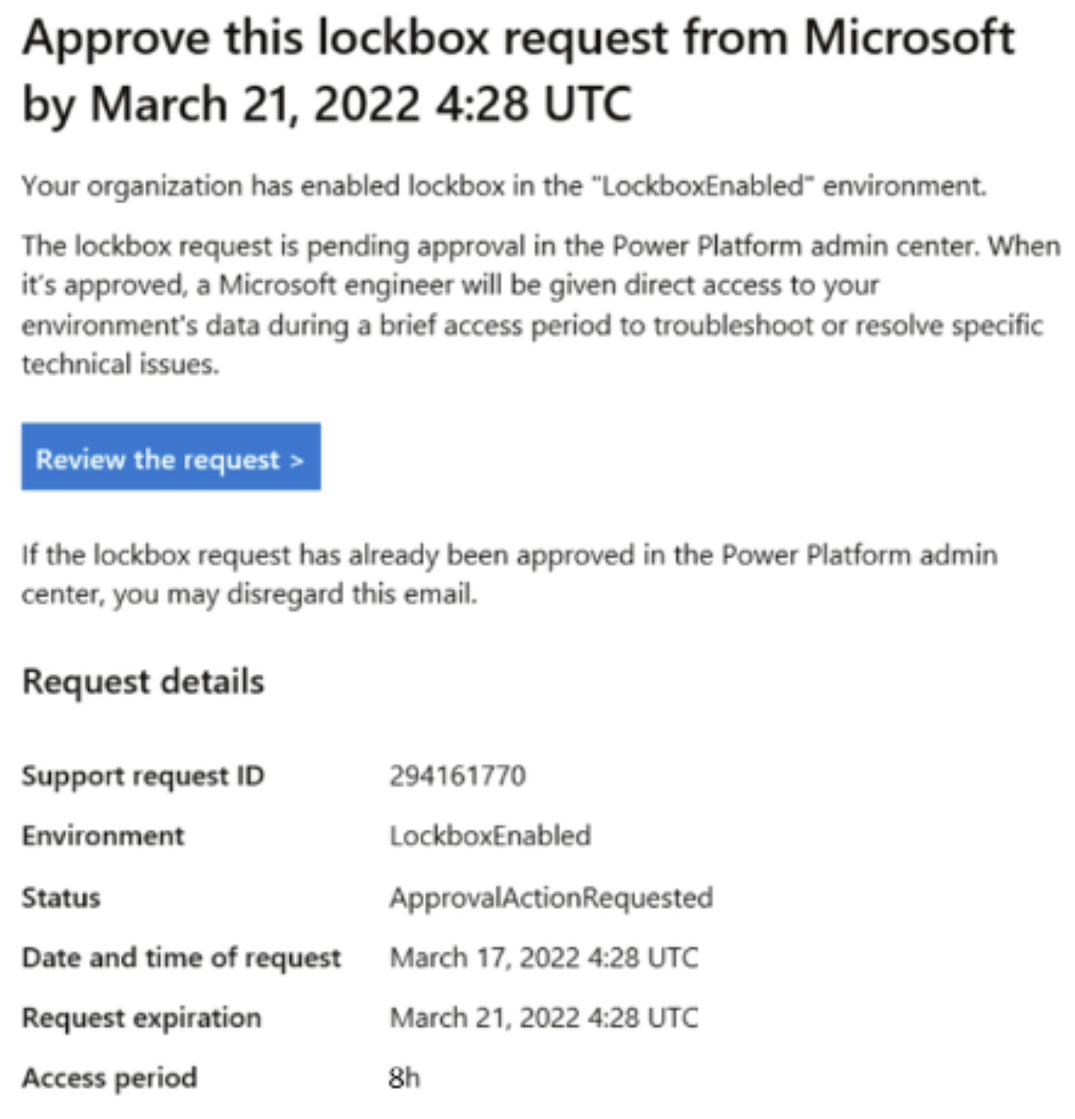
Customer Lockbox - Workflow
Org has an issue and opens case with MS Support.
MS reviews/troubleshoots the case and determines access to customer data is needed – MS triggers internal process for access to customer data, irrespective of lockbox policy being enabled or not.
A lockbox request is generated if the respective environment is protected by lockbox policy. Email is sent to Global Admin and Power Platform Admin.
The approver signs into PPAC and approves the request. The request times out within four days, and no access is granted to MS.
After request is approved, MS obtains elevated permissions and fixes the issue. MS engineers have 8 hours to fix the issue, after which access is revoked.
Microsoft Confidential
Notes:
Securely access customer data using Customer Lockbox in Power Platform and Dynamics 365 - Power Platform | Microsoft Learn

Slide 28
Enterprise Policies

Slide 29
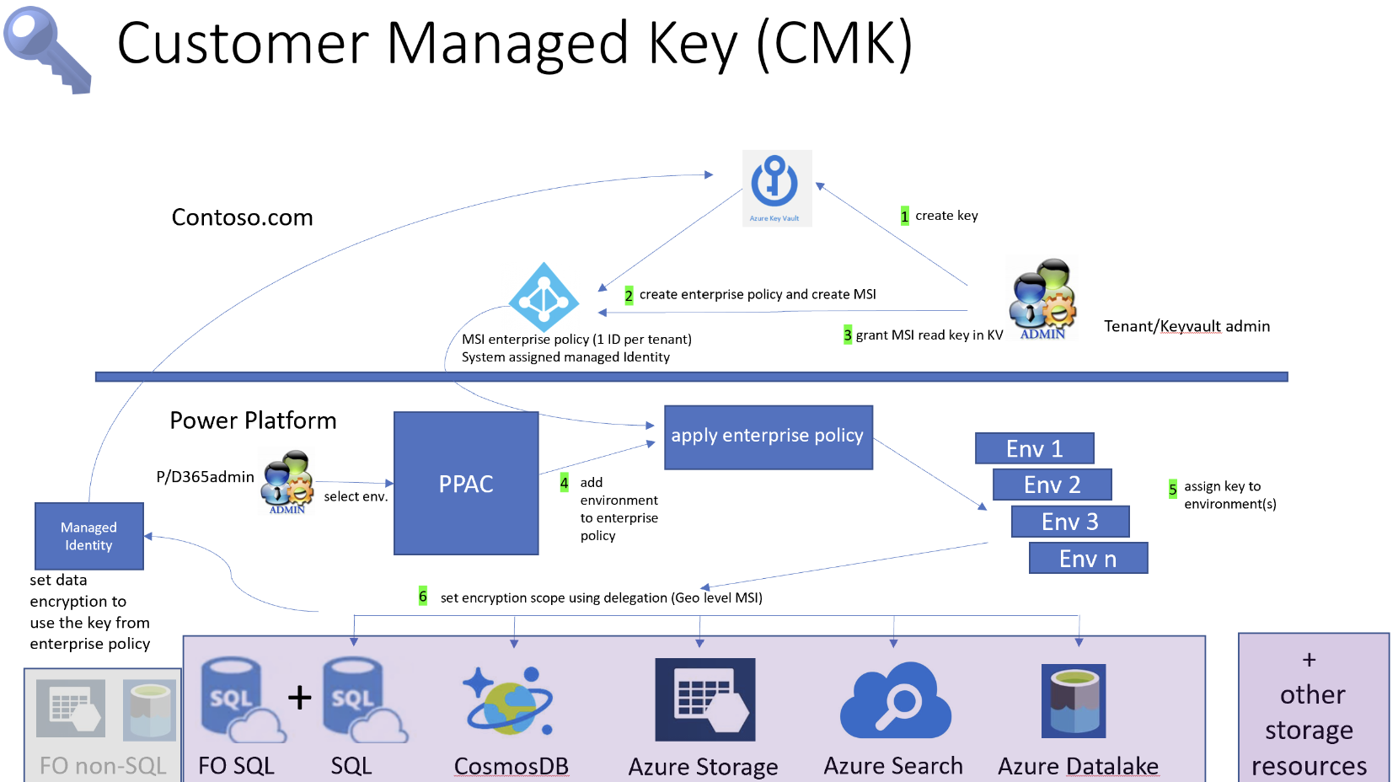
Enterprise Policies – CMK – what is it?
CMK = Customer Managed Key
Customers have data privacy and compliance requirements to secure their data by encrypting their data at-rest.
Data is secure from exposure in an event where a copy of the database is stolen.
With data encryption at-rest, the stolen database data is protected from being restored to a different server without the encryption key.
All customer data stored in Power Platform is encrypted at-rest with strong Microsoft-managed encryption keys by default.
Microsoft stores and manages the database encryption key for all data, so customers don't have to.
What benefits does a Power Platform customer managed key (CMK) provide?
Added data protection control to self-manage the database encryption key associated with Microsoft Dataverse environment(s).
Allows you to rotate or swap the encryption key on demand.
Allows you to prevent Microsoft's access to your customer data when you revoke the key access to our services at any time.
Currently, all your customer data stored only in the following apps and services can be encrypted with customer-managed key:
Dataverse (Custom solutions and Microsoft services)
Power Automate 1
Chat for Dynamics 365
Dynamics 365 Sales
Dynamics 365 Customer Service
Dynamics 365 Customer Insights
Dynamics 365 Omnichannel
Dynamics 365 Commerce (Finance and operations)
Dynamics 365 Field Service
Dynamics 365 Retail
Dynamics 365 Finance (Finance and operations)
Dynamics 365 Intelligent Order Management (Finance and operations)
Dynamics 365 Project Operations (Finance and operations)
Dynamics 365 Supply Chain Management (Finance and operations)
Dynamics 365 Fraud Protection (Finance and operations)
Microsoft Confidential
Notes:
Manage your customer-managed encryption key in Power Platform - Power Platform | Microsoft Learn

Slide 30
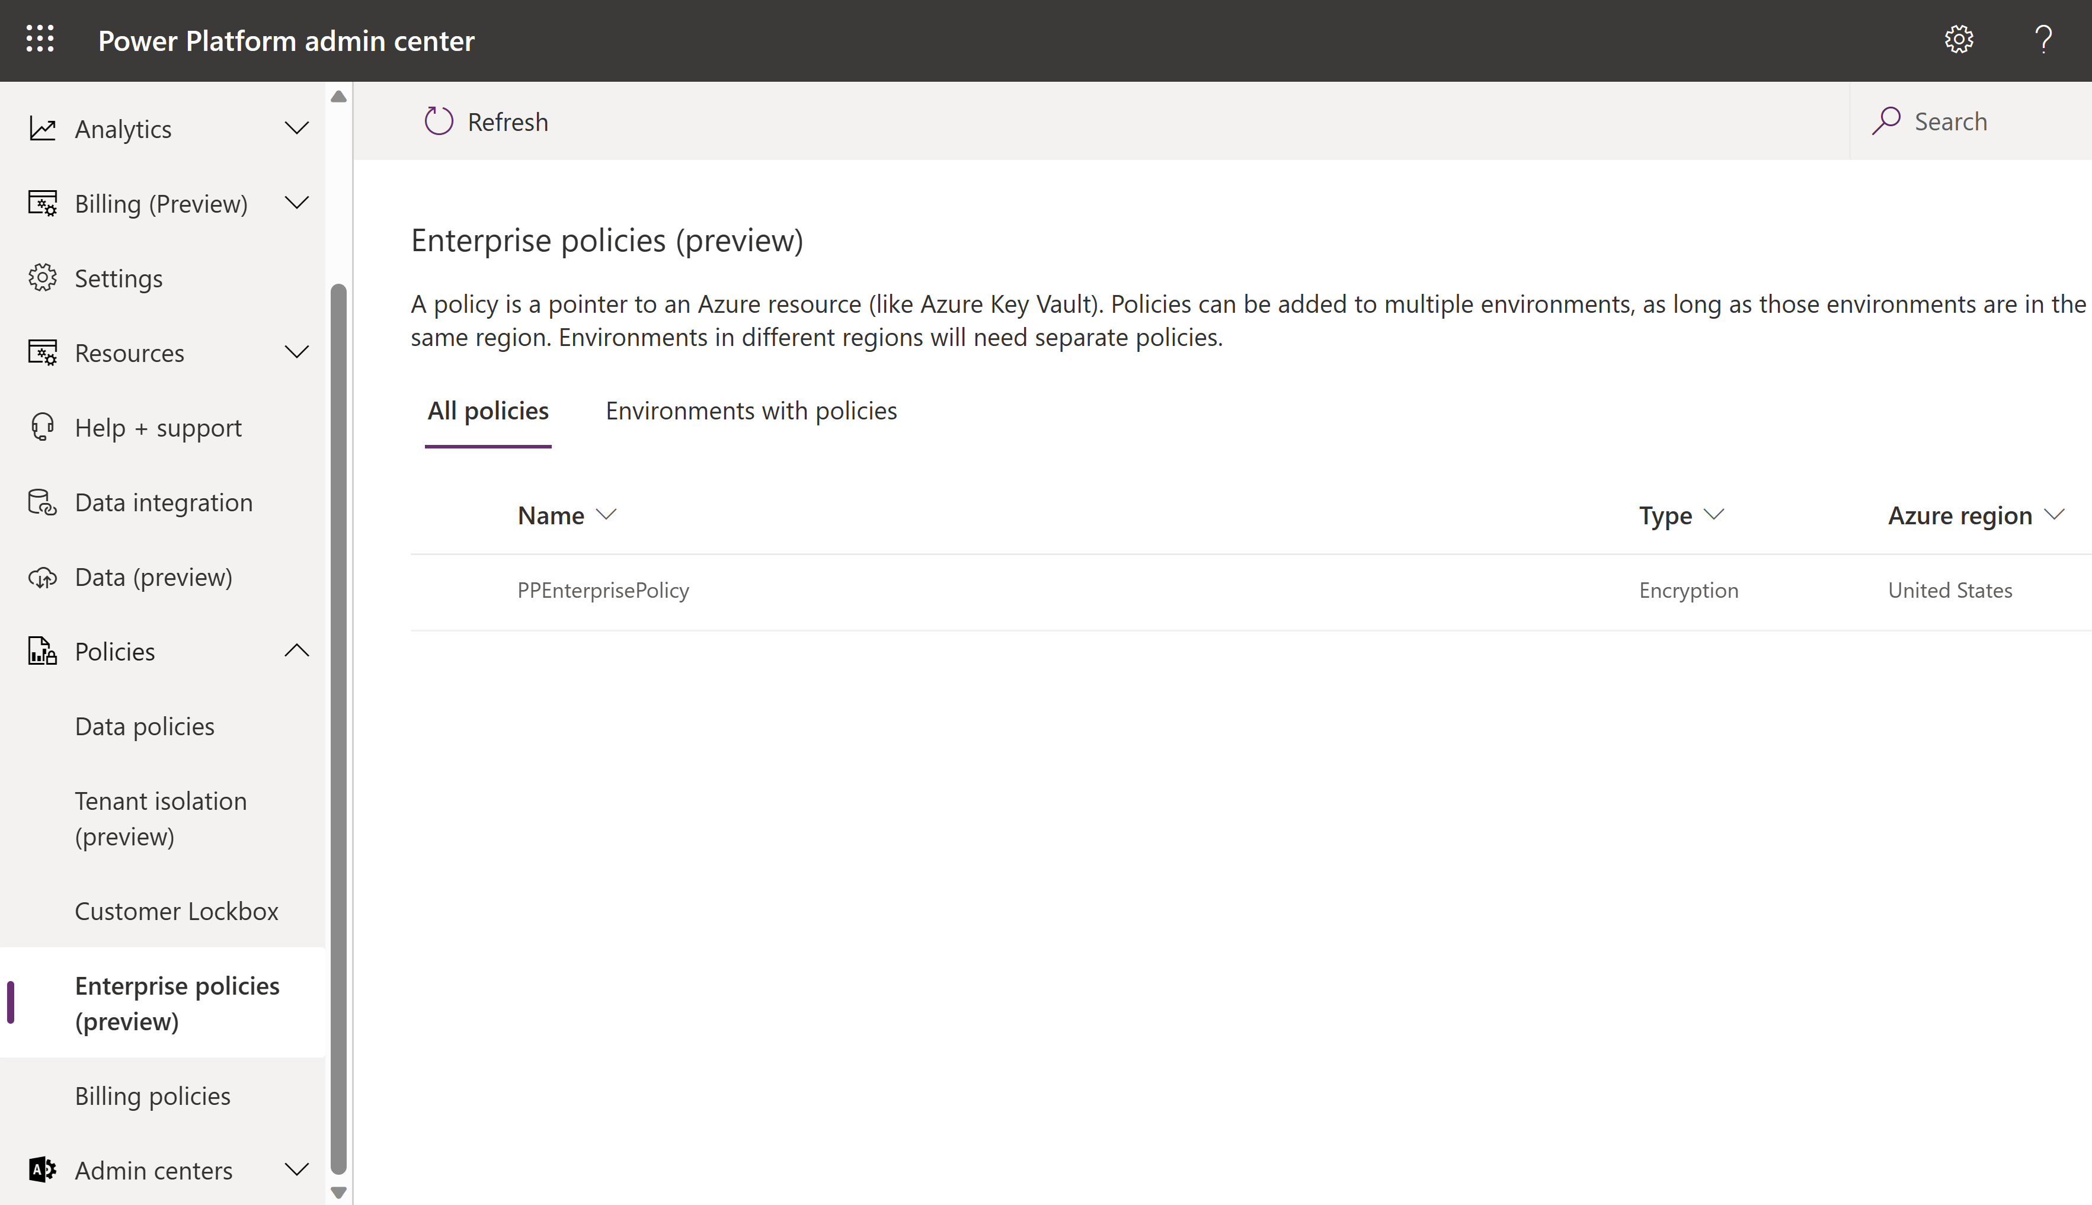
Configuring Enterprise Policies
Understand the potential risk when you manage your key - As with any business-critical application, personnel within your organization who have administrative-level access must be trusted. Before you use the key management feature, you should understand the risk when you manage your database encryption keys. It's conceivable that a malicious administrator (a person who is granted or has gained administrator-level access with intent to harm an organization's security or business processes) working within your organization might use the manage keys feature to create a key and use it to lock your environments in the tenant.
Prerequisites
An Azure subscription that includes Azure Key Vault.
Global tenant admin or an Azure AD with contributor permission to the Azure AD subscription and permission to create an Azure Key Vault and key. This is required to set up the key vault.
Power Platform administrator must be assigned to either the Power Platform or Dynamics 365 Service administrator Azure AD role.
Steps to configure - the following steps link to detailed step by step documentation:
Create encryption key and grant access
Enable the Power Platform enterprise policies service for your Azure subscription
Create enterprise policy
Grant enterprise policy permissions to access key vault
Grant the Power Platform admin privilege to read enterprise policy
Add an environment to the enterprise policy to encrypt data
Notes:
Manage your customer-managed encryption key in Power Platform - Power Platform | Microsoft Learn

Slide 31
Billing Policies

Slide 32
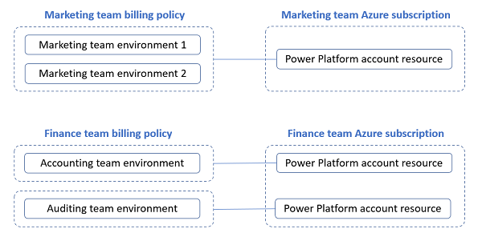
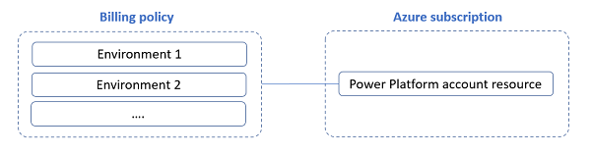
What is a billing policy?
A billing policy creates a link between one or more environments and an Azure subscription. Used for PAYGO licensing models.
It consists of:
Details of the Azure subscription
A list of environments that are linked to the Azure subscription
Can be created in either PPAC or within Power Apps and Power Automate.
When a policy is created, a corresponding Azure resource (called a Power Platform account resource) is created in the Azure subscription associated with that billing policy.
Any usage charges for Power Apps, Power Automate, Dataverse, and Microsoft Power Platform requests will appear under the Power Platform account resource on the Azure subscription's bill.
When an environment is linked to Azure via a billing policy, it becomes a pay-as-you-go environment.
An environment can only be linked to one billing policy at a time.
Environments can be removed from a policy at any time
It goes back to a regular environment.
If a user has a premium per user license – it is used instead of PAYG
Microsoft Confidential
Notes:
Set up a pay-as-you-go plan - Power Platform | Microsoft Learn

Slide 33
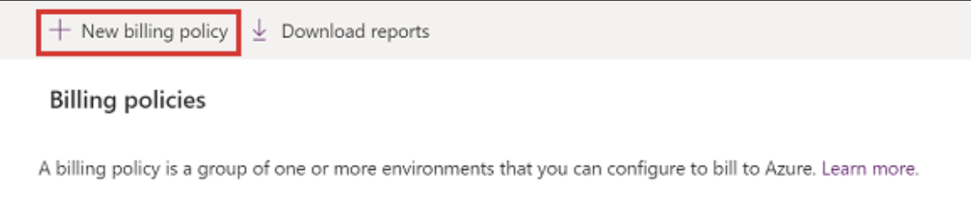
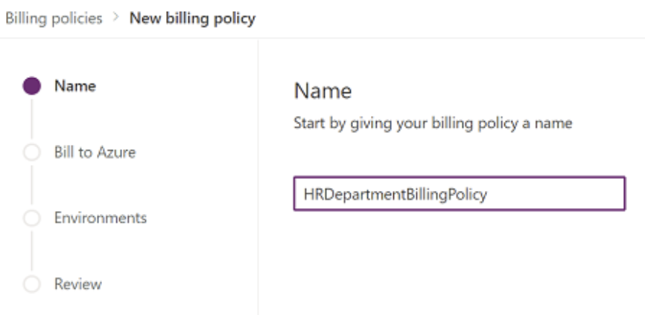
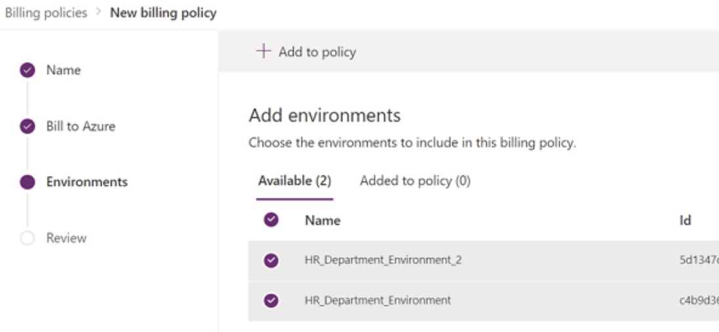
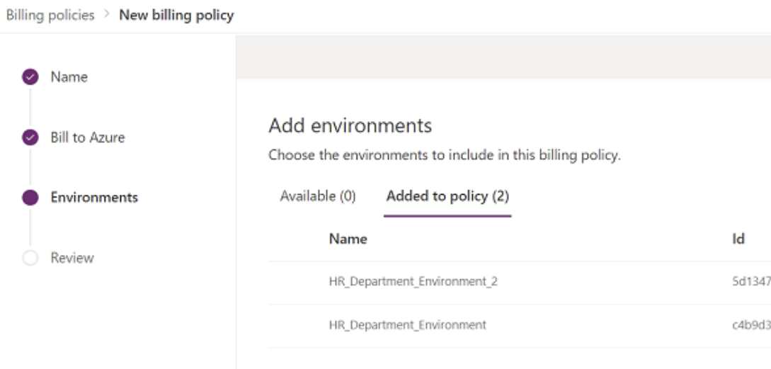
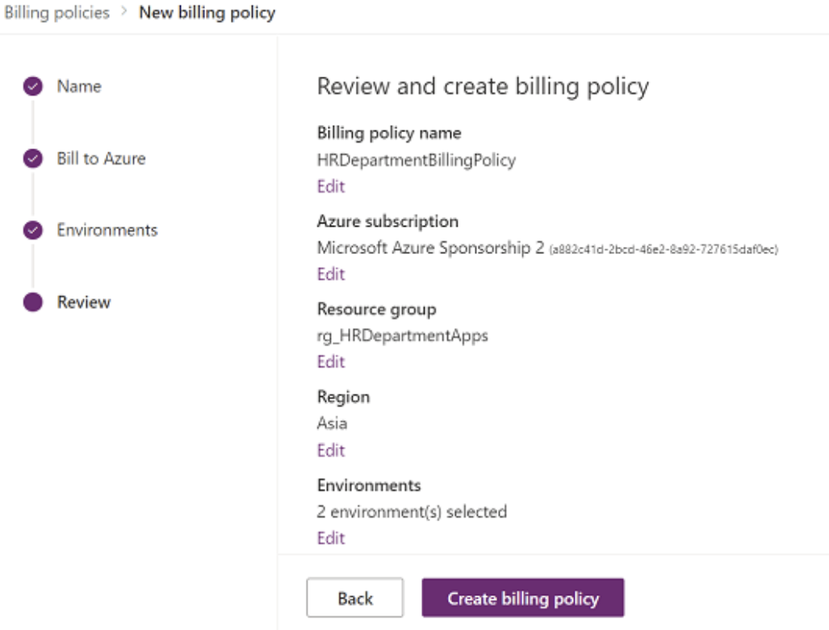
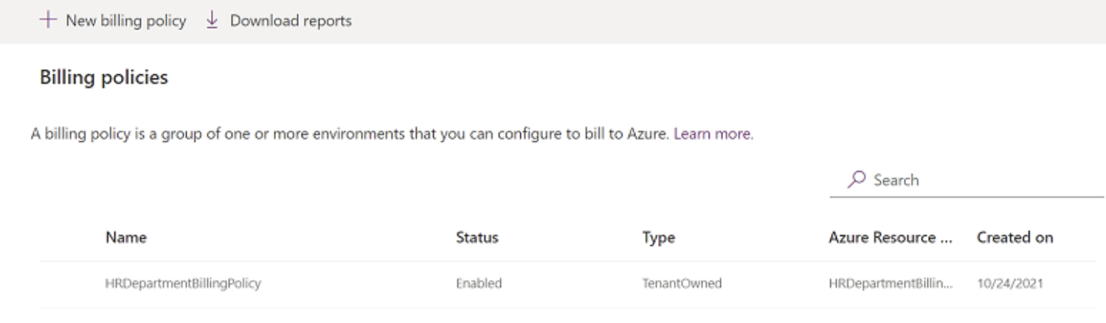
Setup billing policy/PAYGO
In order to set up pay-as-you-go billing for an environment, you first need an active Azure subscription that you can link to that environment. We recommend to configure this in PPAC.
Who can set these up?
Power Platform Admin, Dynamics 365 Admin, Global Admin.
Environment Admin – Can only link environments they are admins for and only to policies they create.
Steps to configure
First, procure or create an Azure subscription you can use
Navigate to Billing policies in PPAC and click New Billing Policy.
Provide a name for your new billing policy, and then select Next.
Add Azure subscription details
Choose the azure subscription to bill from the drop-down list.
Specify a resource group with that subscription.
Specify a region
Select Next
Choose environments to link to the new billing policy.
Select one or more environments and click Add to Policy
Note: Only production or sandbox environments are available to add currently.
Review and confirm.
Optional: View the billing policy’s Power Platform Account resource in the Azure Portal. Navigate to https://portal.azure.com/ > select the subscription > resource group > select view hidden types above resource list > You’ll see a Power Platform account resource with the same name as the billing policy created.
Microsoft Confidential
Notes:
Set up a pay-as-you-go plan - Power Platform | Microsoft Learn

Slide 34
Questions?

Slide 35
Lab 1 and 2
Lab Description
Lab 1. Create DLP Policy in Power Platform Admin Center Lab 2. Create DLP Policy using PowerShell
Notes:
Link to lab: https://labondemand.com/LabProfile/
##########

Slide 36
Microsoft

